Slide 1

Heliospheric Propagation & Forecasting of Coronal Mass Ejections
David Webb
ISR, Boston College, USA
IPS Workshop
Nagoya, Japan
23-24 November 2013

Slide 2
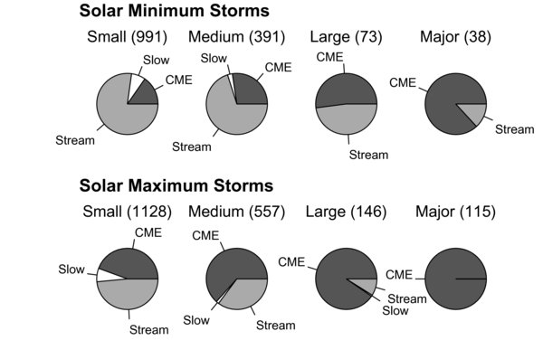
Storm Size vs. Assoc. Solar Wind Structures
Flow types vs aa index: 1964-2011
Small - Medium Storms
18% → ICMEs
75% → HS streams
Large – Major Storms
64% → ICMEs
39% → HS streams
Small - Medium Storms
50% → ICMEs
44% → HS streams
Large – Major Storms
94% → ICMEs
05% → HS streams
Richardson et al., GRL (2000; 2002)
Richardson & Cane, SWSC (2012)

Slide 3
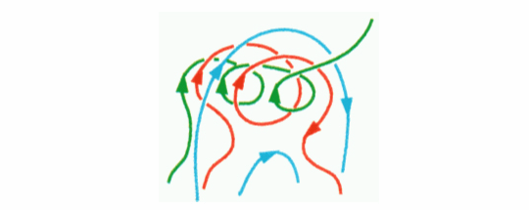
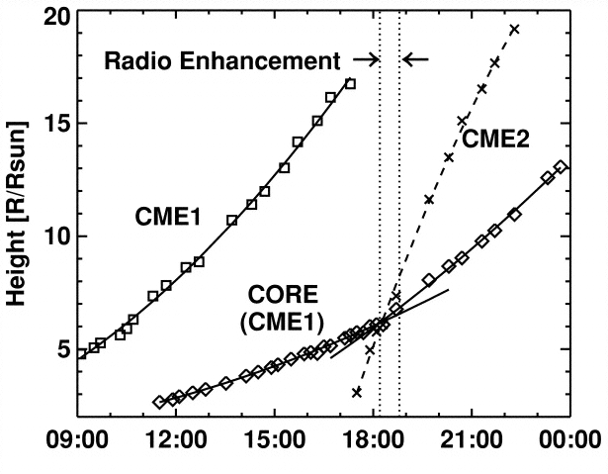
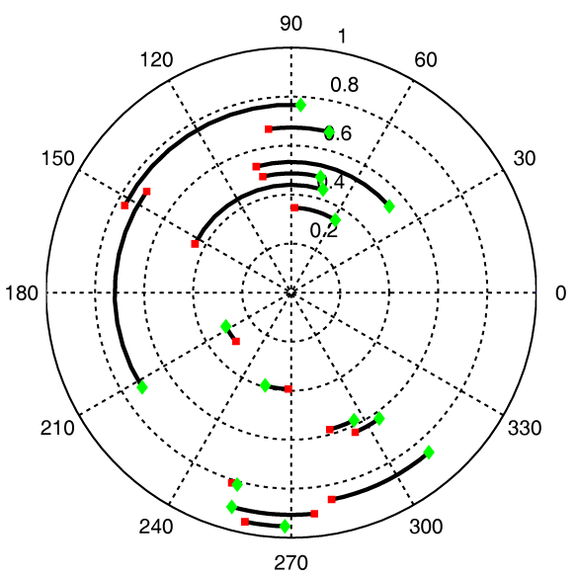
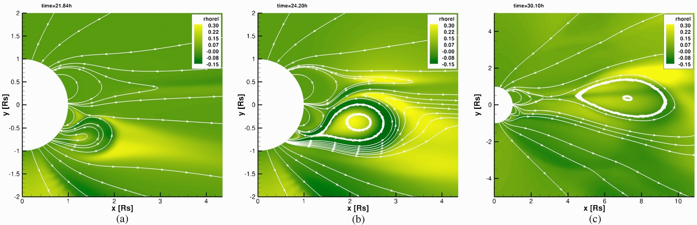
Interplanetary Propagation Effects:
CMEs → ICMEs
Reconnection in CMEs: Interchange reconnection can open some CME field lines, resulting in open embedded in closed field lines (e.g., Gosling et al., GRL, 1995; Lugaz et al., ApJ (2011) ).
Interaction of Slow & Fast CMEs: Gopalswamy et al., Ap.JL (2001)
CME Deflections: Isavnin et al, SP (2012); Zuccarello et al., ApJ (2012)
CME Rotations: Isavnin et al, SP (2012)
In-situ
Imaging

Slide 4
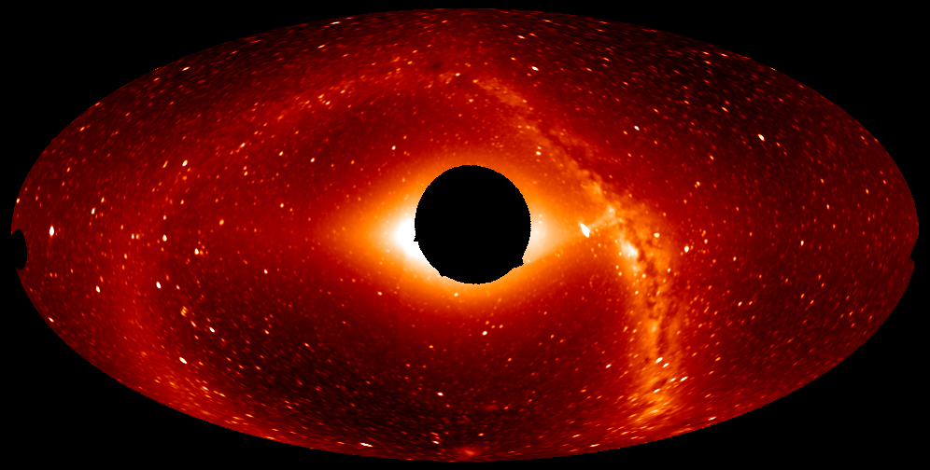
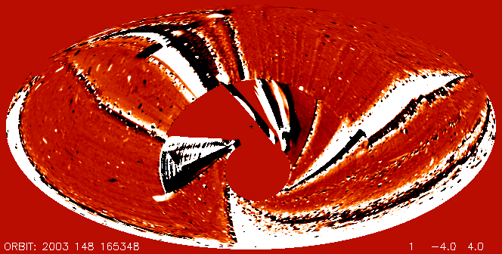
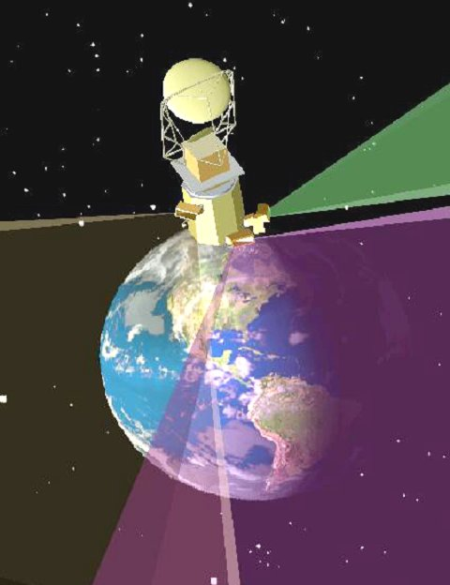
Solar Mass Ejection Imager (SMEI)
Proof-of-concept USAF experiment to detect &
track CMEs in inner heliosphere - 2003.
Challenge: to detect signal at 1% of background.
SMEI observed for 8.5 years; turned off Sept.
SMEI observed ~400 CMEs.
Rate is 0.3 CMEs/day
Avg. brightness ~ 1 S10
SMEI detected ~40 Earthward CMEs. Could detect &
track CMEs 10–23 hr. before Earth arrival.
SMEI also detected auroral light geoactivity (Kp >4).
SMEI Composite All-sky Image
Earth-directed CME, May 2003

Slide 5
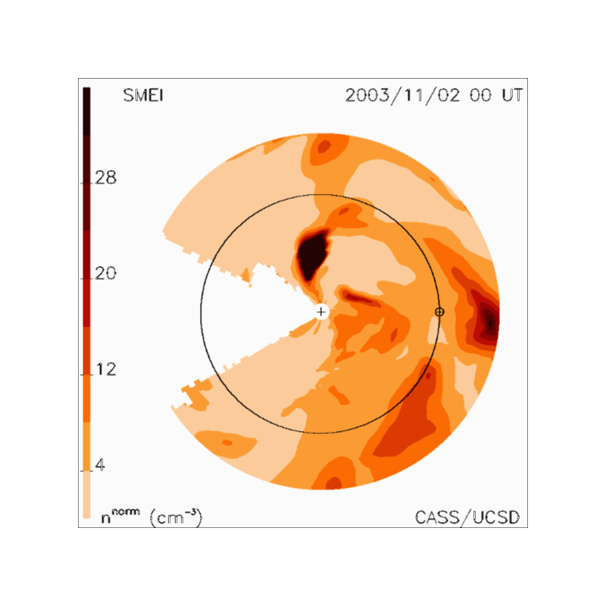
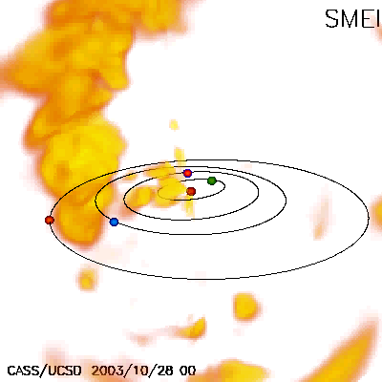
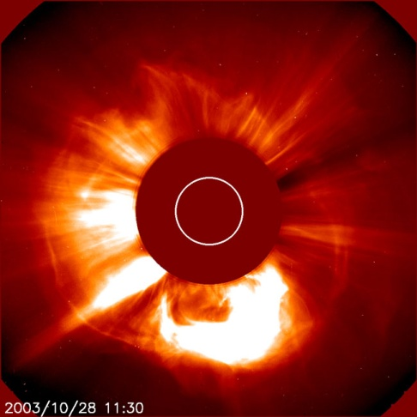
SMEI 3-D Reconstruction of 28 Oct 2003 CME
28 Oct. X17 flare; halo
CME: LASCO C2

Slide 6
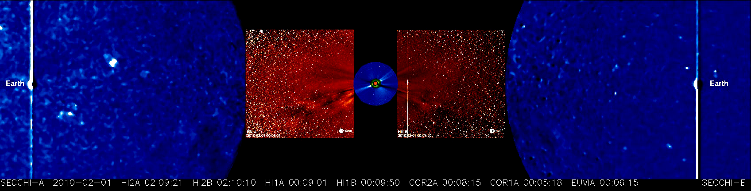
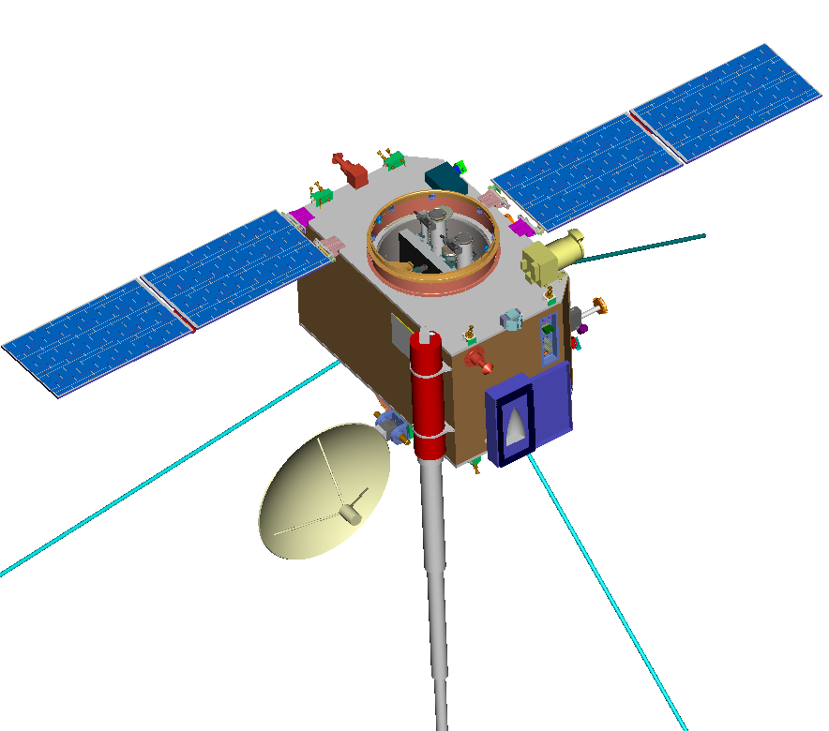
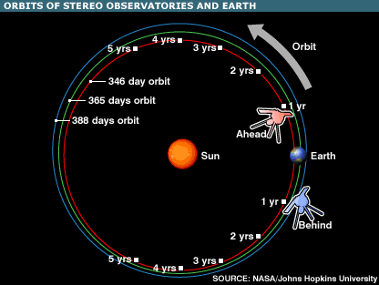
Imaging the Heliosphere with STEREO
White Light Observations
SCIP
Plastic
HI
SWAVES
Boom (3x)
IMPACT
Boom

Slide 7
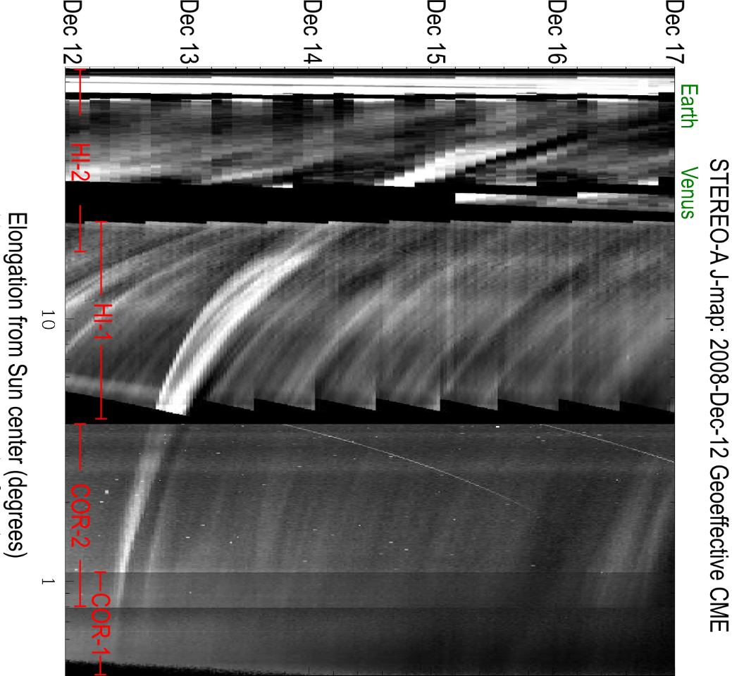
CME Anatomy Science
9
Howard & DeForest, ApJ, 2012

Slide 8
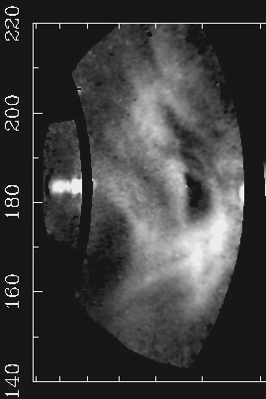
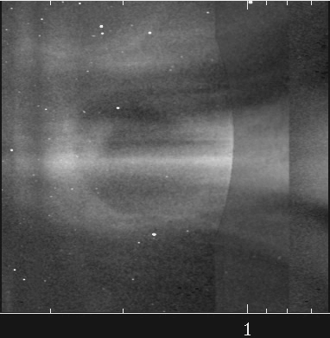
Track CME Flux Rope in Heliosphere
HI-2A
COR-2A
10
Howard & DeForest, ApJ, 2012

Slide 9
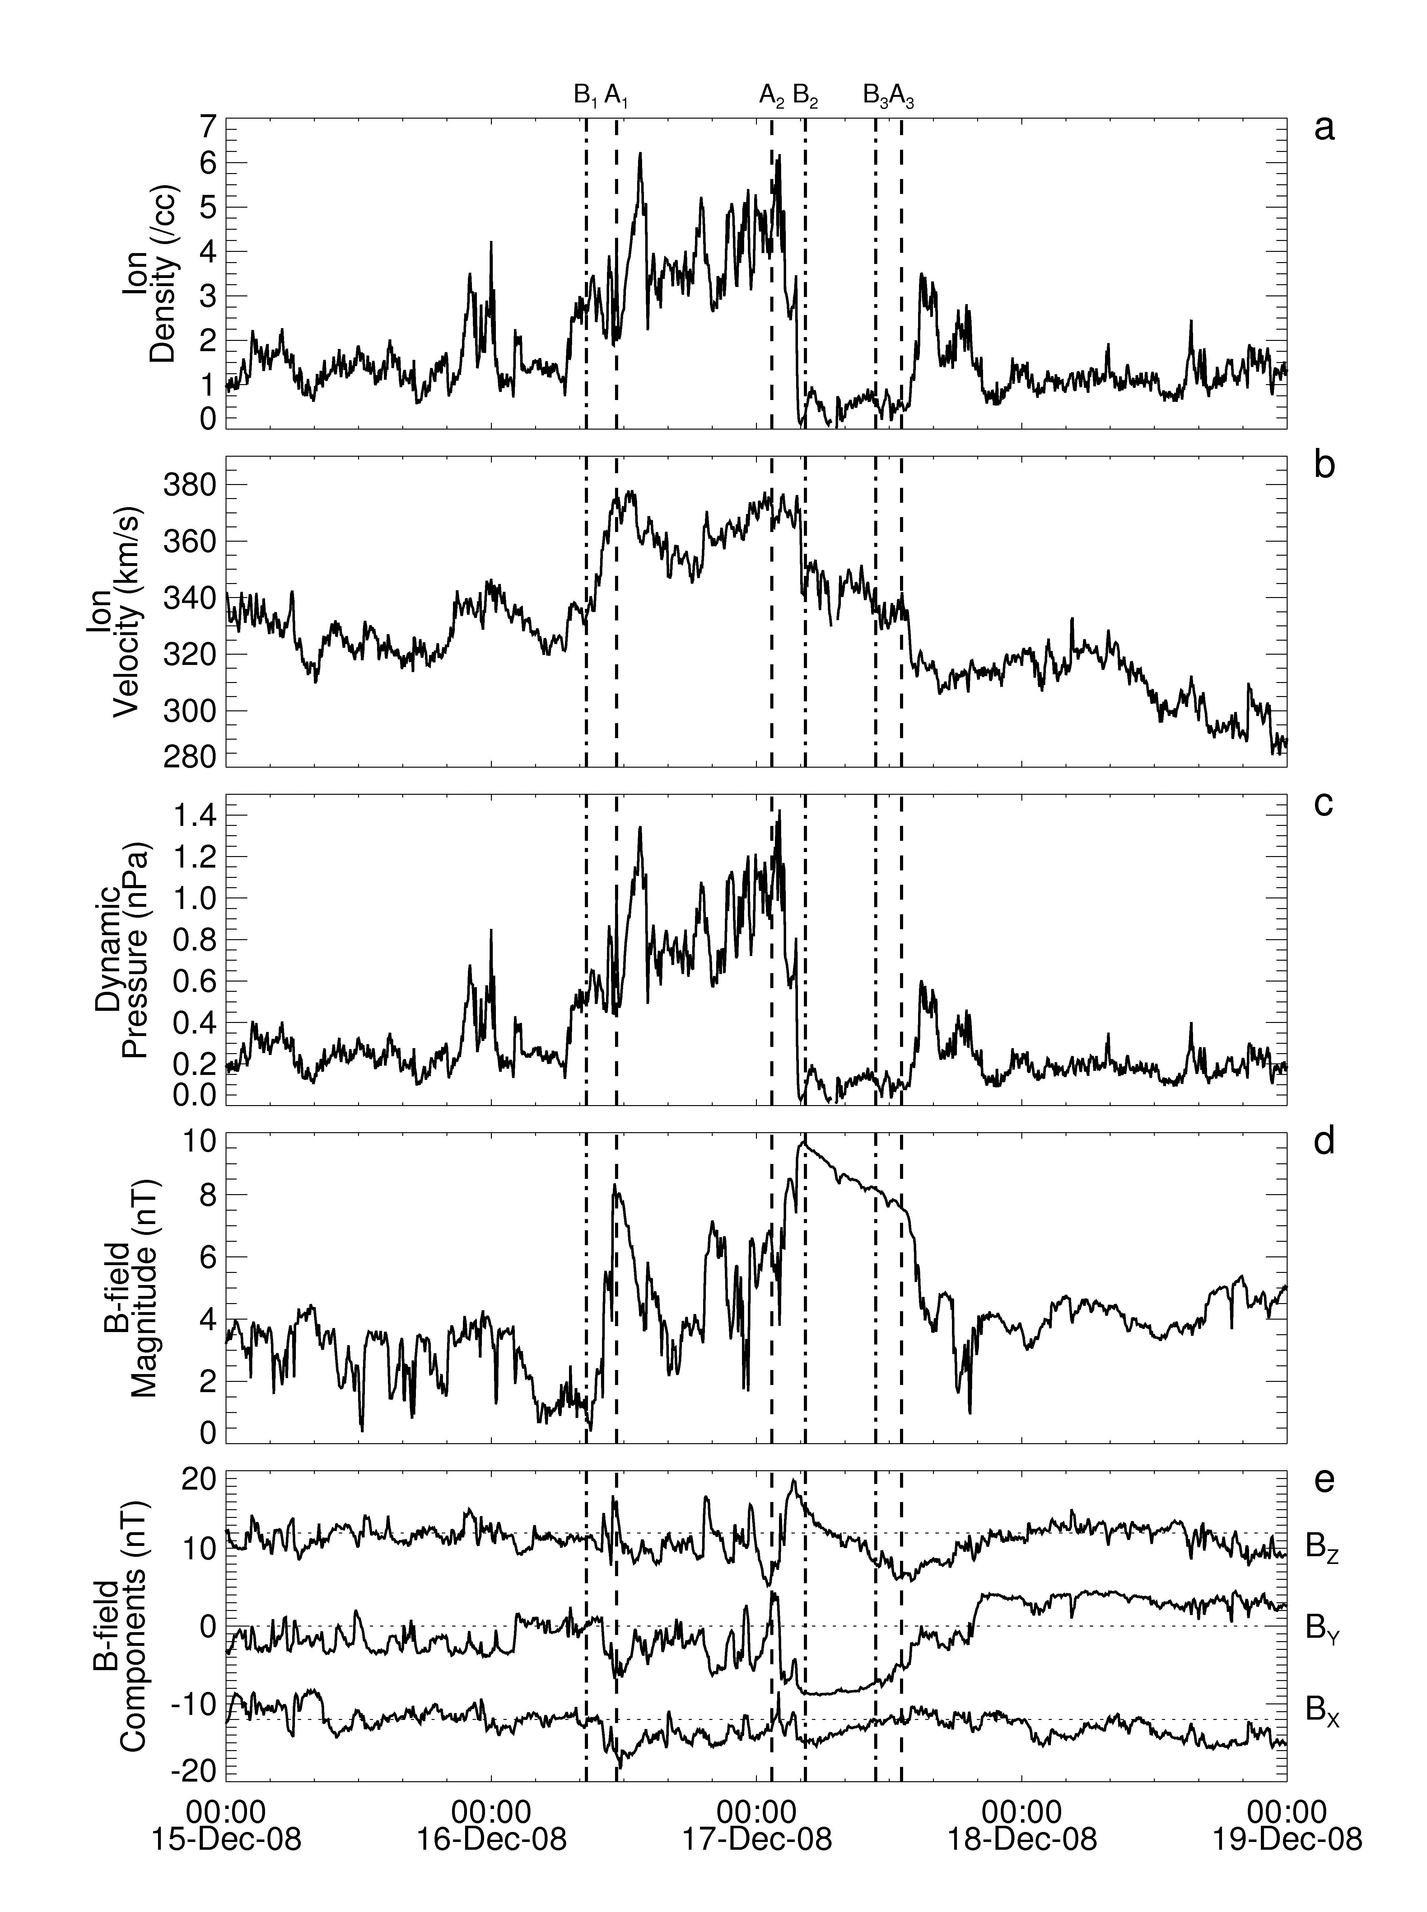
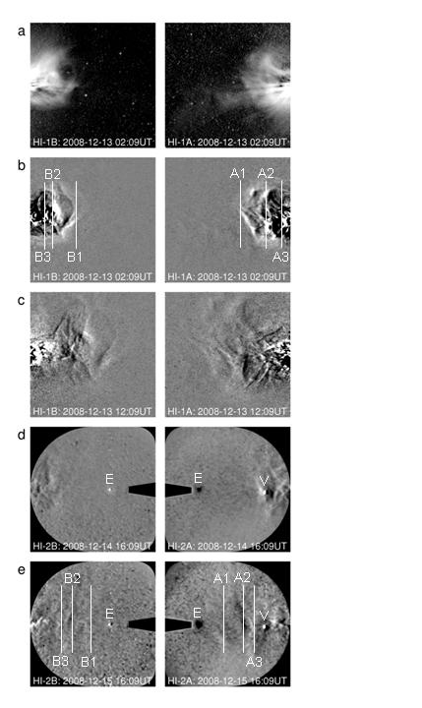
December 2008 CME – HIs & In-situ Obs.
Assoc. with N eruptive prominence
Earth directed & seen at ACE
Dotted lines are at the times when structure boundaries in HI2 crosses the LOS to ACE
Only modestly geoeffective: Kp=3 for ~1 day
CME core may have passed to north
Davis et al. (2009)

Slide 10
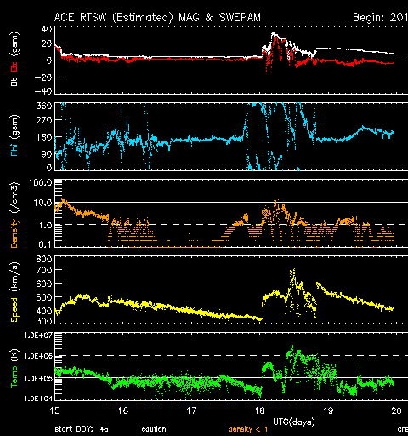
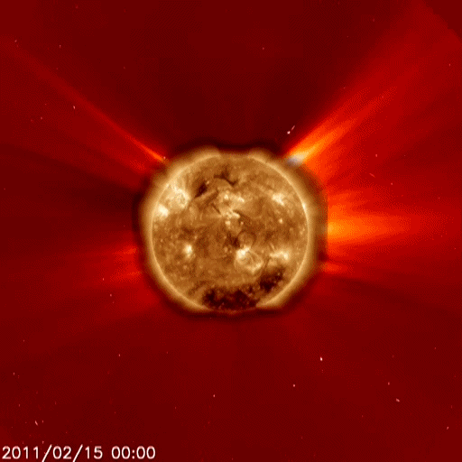
15 - 18 February 2011 Event
AIA 193Å disk image inside LASCO C2
white light image.
ACE plasma and magnetic field data showing L1 arrival of ICME – shock structures on Feb. 17 – 18.

Slide 11
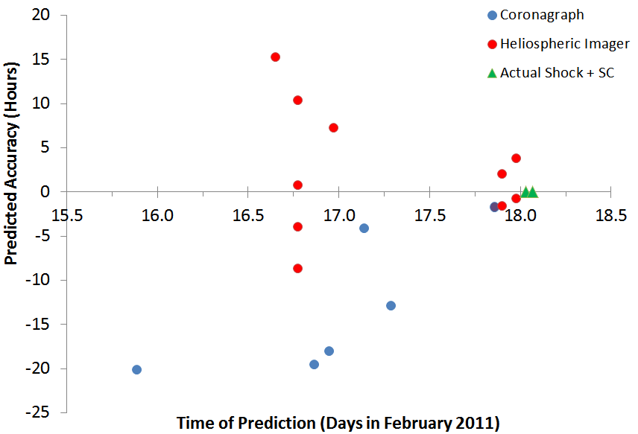
STEREO SWx Group Forecasting of Feb. 2011 Event
Comparison with Other Forecasting Models
late
T-H 1
Late
S-R
T-H 2
T-H 5a
T-H 4a
S-R
T-H 4b
T-H 5b
S-R
HAFv2
LASCO
HM
Early
STOA
LASCO
Localization
ENLIL
Courtesy T. Howard
early

Slide 12
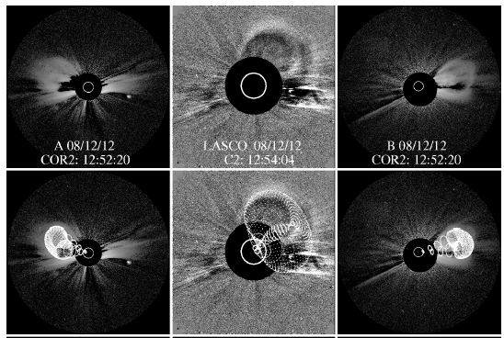
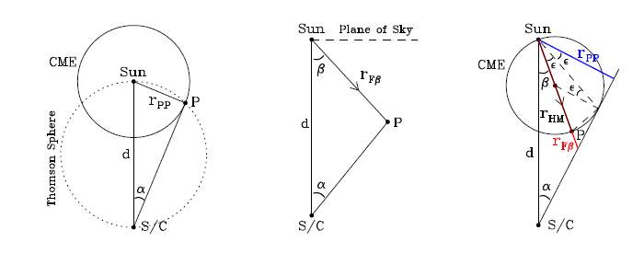
Methods for Measuring CMEs in 3-D
Direct Reconstruction
  Forward Modeling (Thernisien et al.; Wood et al.)
Geometric techniques
  Triangulation
    Using images (H-t)
    Using J-maps (ε- t) (Liu et al. 2010)
    Using masses (Colaninno & Vourlidas 2009)
    Using polarization (de Koning et al. 2009)
  Point-P (Howard et al., 2007)
  Fixed-φ (Sheeley et al.‚ 1999; Kahler & Webb 2007)
  Harmonic Mean (Lugaz et al. 2009; Lugaz, 2010)
  Self-similar expansion (Möstl & Davies, 2012)
P
φ
H-M
Courtesy A. Vourlidas

Slide 13
Conclusions for SWx Predictions
Assessed prediction performance for 3 events using 12 techniques/models by the STEREO SWx Group.
- An initial guide but need more events to build statistics and evaluation.
For the 3 events, the difference between the predicted and actual arrival times, “accuracy”, averaged 8.0 hr., with a large range.
- An improvement over typical T of A uncertainties in literature of 11 – 12 hr.
The Lead or Warning Time averaged ~1 day, with a large range
- Combination of long lead times and accurate arrival times is most desirable
- Techniques using the COR2 and SMEI & STEREO HI data scored best
However, the enhanced performance used only the STEREO Beacon data → I.e., reduced cadence (2 hr), incomplete temporal coverage (missing images) and reduced spatial resolution.
- Davis et al. (2011) showed that the STEREO science data would have yielded better predictions → thus, a dedicated SWx imager(s) will provide best performance.
NB: Feb 2011 event illustrates that many CMEs this cycle have mostly northward fields, reducing their geoeffectiveness.

Slide 14
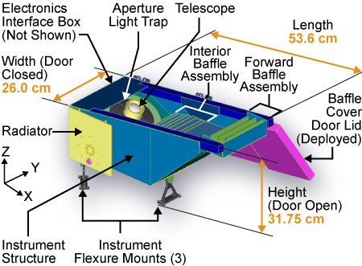
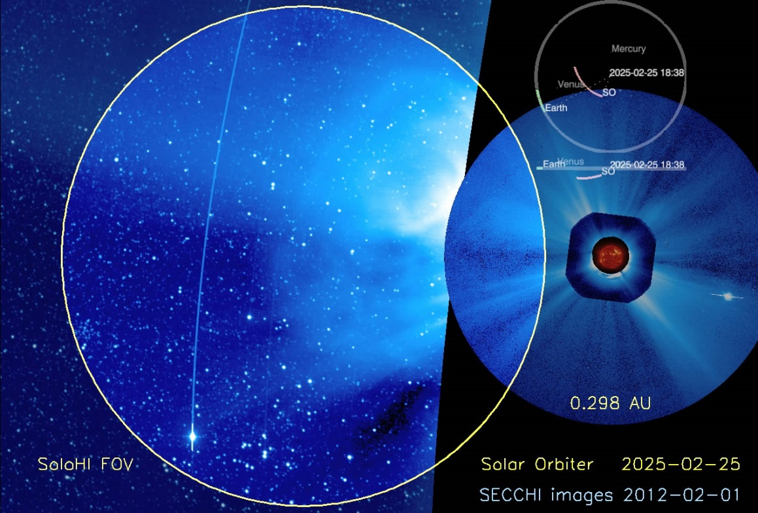
Wide-field Heliospheric Imagers on Solar Probe (WISPR) and Solar Orbiter (SolOHI)
Wide-Field Imagers (WISPR: 13.5º - 118º, SOLOHI: 5.5º - 45º from the Sun.)
Visible Light Observations.
Next-Generation 2k x 2k APS Sensor.
WISPR Instrument
Also planning continues on possibility of HIs on missions to L1, L4 or L5 Lagrange points. BUT no real progress so far!
SOLOHI FOV at perihelion (0.28AU)
Courtesy A. Vourlidas

Slide 15
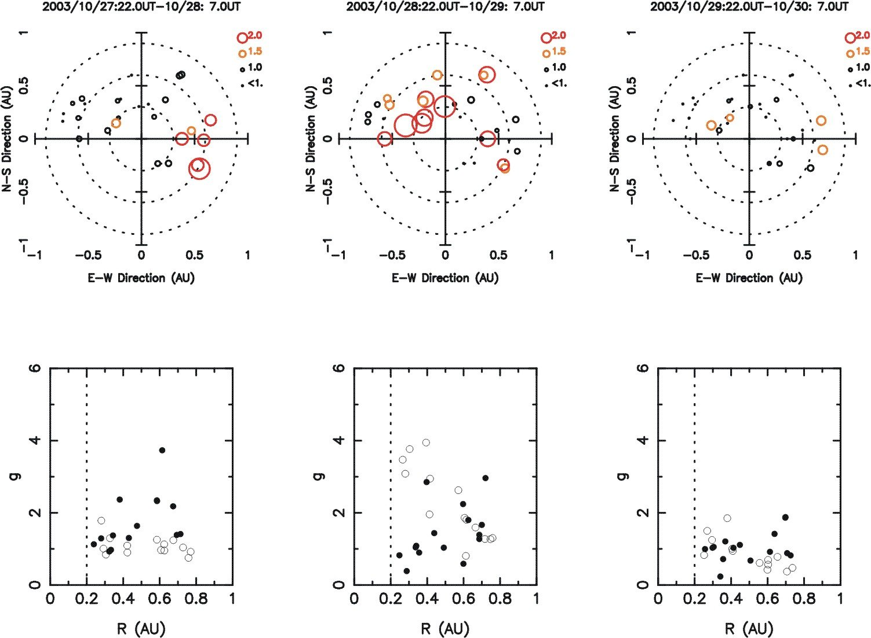
STEL IPS Observations: 28-30 Oct. 2003

Slide 16
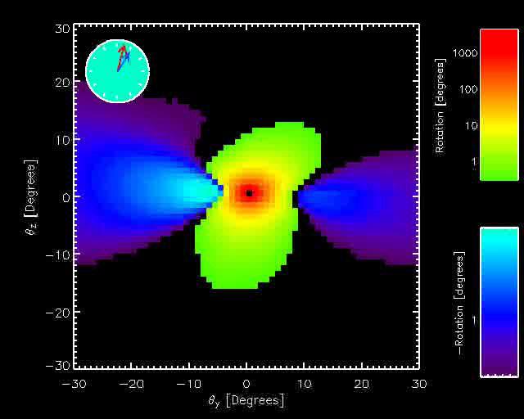
INTERPLANETARY SCINTILLATION (IPS)
MWA-512 (now 128?):
An increase in the number of independent observations (beams) by factor of 16
Enhanced sensitivity by a factor ~5 with increase in no. of radio sources observed (~1-2000)
Increased spectral SNR (3-4X) due to longer observation times allowed by the independent beams
Coverage in Southern Hemisphere & new longitude adding to global IPS coverage: STEL, EISCAT/LOFAR, OOTY, MEXART, KOREA
FARADAY ROTATION
Determine the magnetic field in heliosphere and in CMEs and monitor its evolution from Sun to Earth.
Technique has been successful close to Sun using
  - Spacecraft (Pioneer, Helios, Cassini) T/M - Bird, et al.
  - VLA (1.5 GHz) observing galaxies through corona
  - Mancuso, Spangler…
MWA, etc. (?):
- Use polarized radio sources, unfold rotation ambiguity, remove rotation due to ionosphere (GPS system), and invert Faraday rotation to determine B (BUT need n_{e} : HI’s, IPS)
Simulation for October 28, 2003 CME J. Kasper, CFA
150 MHz
Simulation for October 28, 2003 CME
J. Kasper, MIT

Slide 17
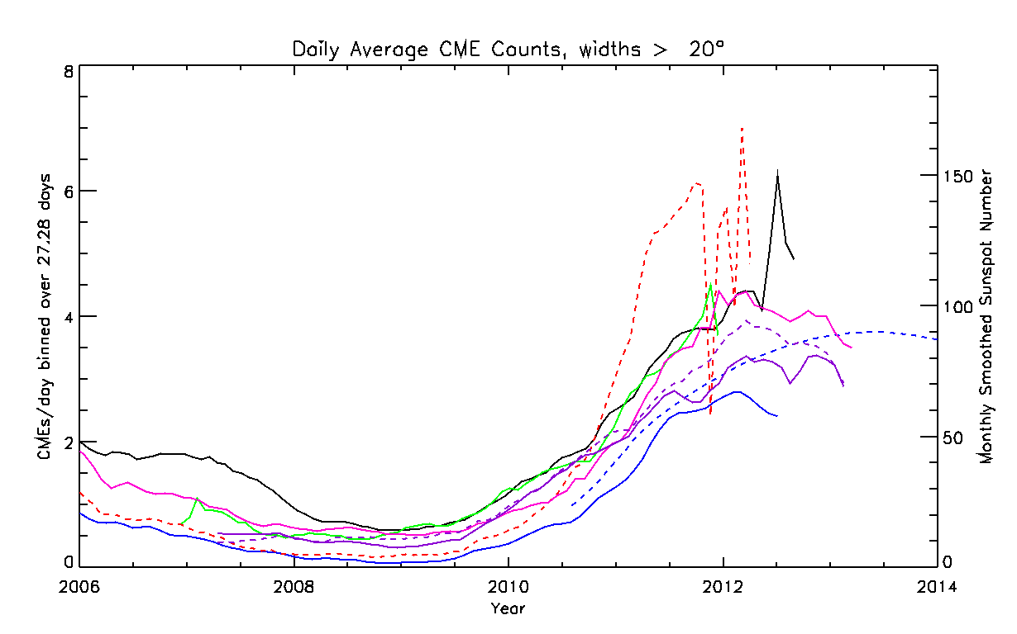
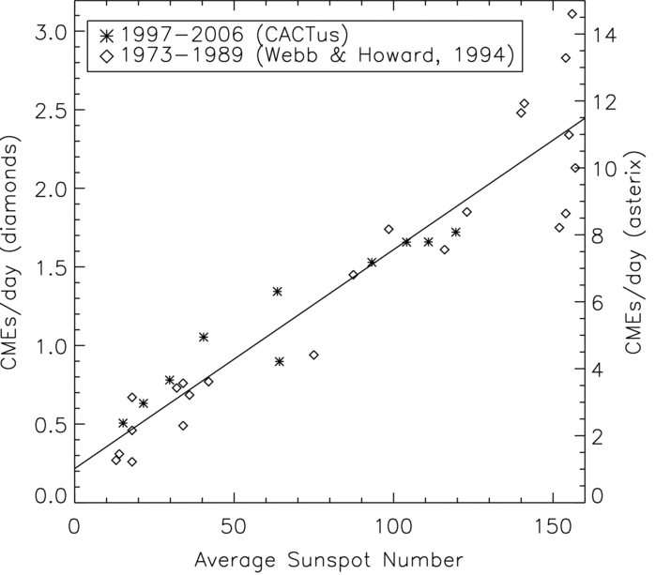
CME Occurrence Rates
LASCO CDAW
LASCO CACTus
LASCO SEEDS (dashed)
STEREO COR1
STEREO COR2A (solid)
STEREO COR2B (dashed)
Actual SSN (solid)
Predicted SSN (dashed)
Annual CME & SSN Rates are
well correlated (r~0.9) over 3 SCs
(Robbrecht et al., 2009)
However in SC 24 CME & SSN rates
may be diverging (Petrie, 2012)
2006 → present. Manual & automatic CME rates from LASCO & STEREO coronagraphs: 6 independent measurements.
Note avg time of minimum for both CMEs & SSN is late 2008. Avg CME rate = 0.35/day.
Pred. SSN max. is ~90 in 2013-14. Actual SSN is tracking below predicted curve.

Slide 18
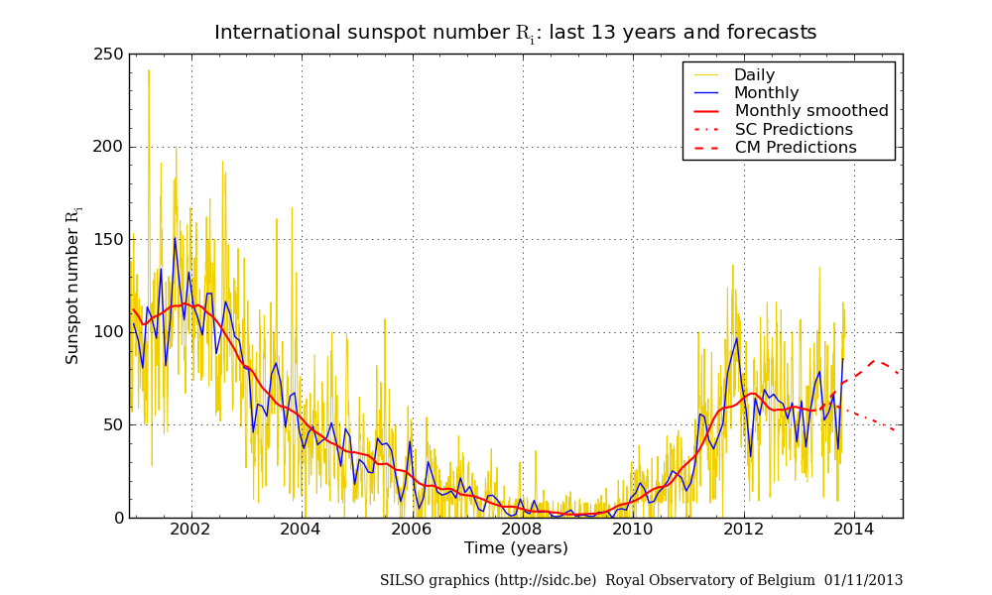

Slide 19
Conclusions
CMEs are a key link bet. solar activity & large IP disturbances
- Fast CMEs drive shocks, key source of hazardous SEP events
- CMEs cause most moderate & major geomagnetic storms → maximum
Earth-directed (halo) CMEs important for Space Weather
- Allow study of CME source regions near Sun center &
- Sampling of internal CME structure along Sun-Earth line
Near cycle maximium, storms are more severe
→ More multiple CMEs, both single mag. clouds & complex ejecta, &
more energetic activity, both at the Sun and at 1 AU
- Fast streams/CIRs from CHs can drive major storms → declining phase
Heliospheric imager data now used to produce 3-D reconstructions of CMEs and to improve our knowledge of Space Weather
- By ~ 2013 there will be no operating HIs capable of making SWx
measurements.
- SOHO is aging. We need followup coronagraphs and HIs to observe and
study transients and forecast SWx.

